Slide 1
Data Analytics Tools in AWS Ecosystem
Bachelor of Engineering- Computer Science & Engineering
Cloud Computing (CC)(23CS009)
Department of Computer Science & Engineering
Chitkara University Institute of Engineering and Technology, Chitkara University, Punjab, India

Slide 2
Data Analytics Tools in AWS Ecosystem
AWS provides a comprehensive suite of data analytics tools, including services for data ingestion, storage, processing, analysis, and visualization.
These tools are designed to help organizations of all sizes and industries gain insights from their data efficiently and cost-effectively.
Key services include Amazon Athena, Amazon EMR, Amazon Kinesis, Amazon Redshift, Amazon QuickSight, and Amazon SageMaker.

Slide 3
Data Ingestion and Storage
Data Ingestion and Storage:
Amazon Kinesis: For real-time data streams from various sources.
Amazon Kinesis Data Firehose: For capturing, transforming, and loading data streams into data stores.
Amazon S3: A highly scalable object storage service used as a foundation for data lakes.
Amazon CloudWatch: For monitoring and analyzing application logs.
AWS Data Pipeline: For orchestrating data movement and transformation.
AWS Glue: A serverless data integration service for ETL (Extract, Transform, Load) tasks.

Slide 4
Data Processing and Analysis
Data Processing and Analysis:
Amazon Athena: A serverless query service for interactive analysis of data stored in S3.
Amazon EMR: A managed Hadoop and Spark platform for processing large datasets.
Amazon Redshift: A fully managed, cloud-based data warehouse for fast and scalable analytics.
Amazon OpenSearch Service: For real-time search and analytics, including log analysis.
Amazon SageMaker: An integrated platform for machine learning and AI, offering tools for model building, training, and deployment.

Slide 5
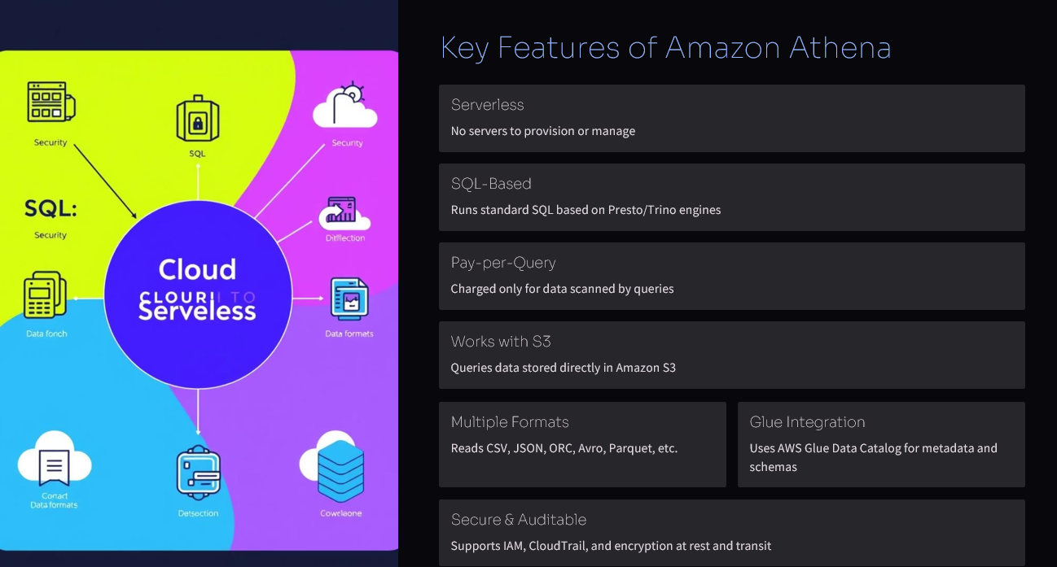
Amazon Athena
Amazon Athena – Serverless Interactive Query Service
Amazon Athena is a serverless query service that analyzes data directly in Amazon S3 using standard SQL. It provides fast, cost-effective results without any infrastructure management.

Slide 6
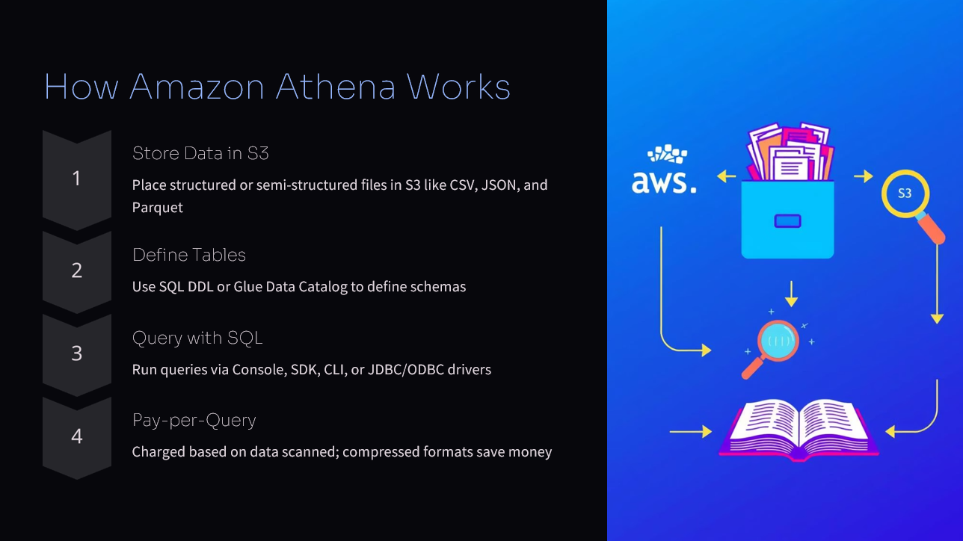
Amazon Athena

Slide 7
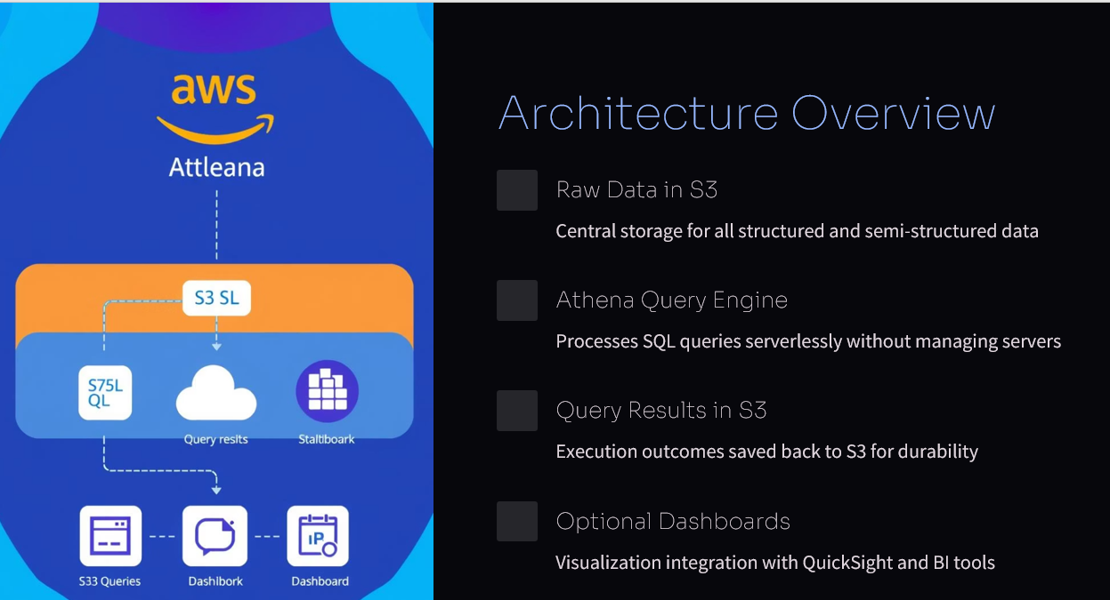
Amazon Athena

Slide 8
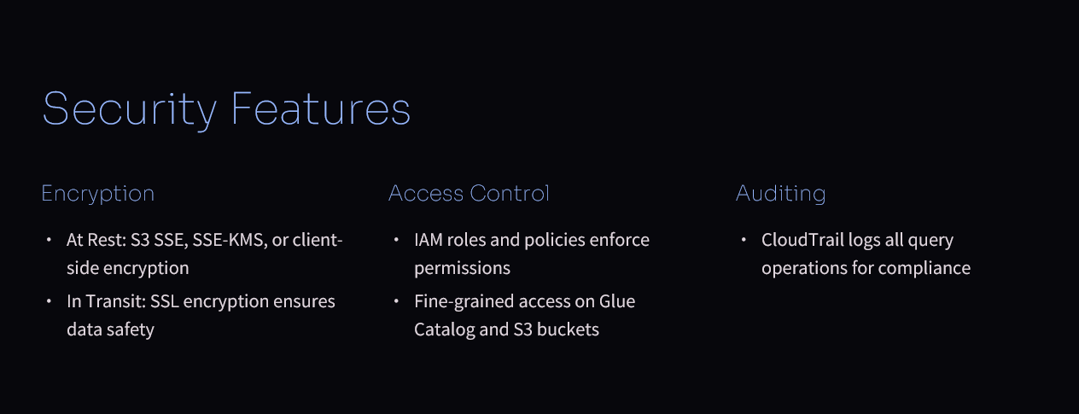
Amazon Athena

Slide 9
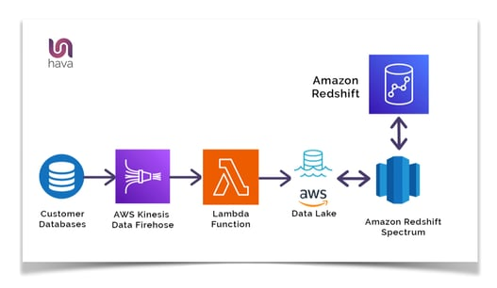
AMAZON REDSHIFT
Amazon Redshift is a fully managed, petabyte-scale data warehouse service in the cloud that makes it easy to analyze large amounts of data using standard SQL and your existing BI tools. It's designed for analytical workloads and offers fast query performance at a cost-effective price.
Use Cases:
Business Intelligence (BI) and Reporting: Analyze large datasets to gain insights and generate reports.
Data Mining and Analytics: Explore and discover patterns in your data using advanced analytical techniques.
ETL (Extract, Transform, Load): Load data from various sources and transform it for analysis.
Data Warehousing: Store and manage large volumes of data for analysis.
In essence, Amazon Redshift is a powerful and versatile cloud data warehouse that can help businesses of all sizes analyze their data effectively and efficiently.

Slide 10
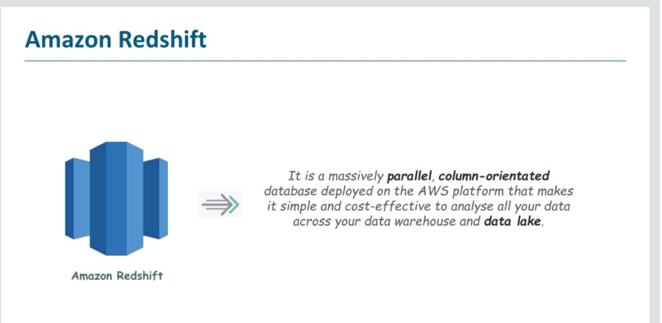
AMAZON REDSHIFT

Slide 11
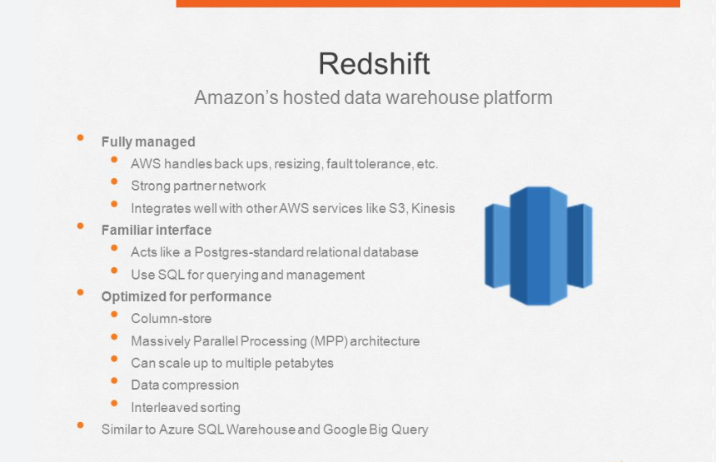

Slide 12
AMAZON KINESIS
Key Features and Capabilities:
Real-time Data Processing:
Kinesis enables immediate processing and analysis of data as it arrives, rather than waiting for batch processing.
Scalability:
It can handle large volumes of data from thousands of sources with low latency.
Serverless Architecture:
Managed by AWS, Kinesis eliminates the need for infrastructure management.
Variety of Data Sources:
Supports various data types, including logs, application data, IoT telemetry, and video streams.
Enhanced Fan-Out:
Allows multiple consumers to access data from the same stream, improving performance and reducing congestion.
Data Retention:
Data can be stored in Kinesis for a specified period, allowing for replay and analysis.
Amazon Kinesis is a fully managed, serverless service from Amazon Web Services (AWS) designed for real-time data streaming. It allows developers to collect, process, and analyze data streams from various sources at a large scale. Kinesis offers different services like Kinesis Data Streams, Kinesis Data Firehose, and Kinesis Video Streams, each serving different use cases.

Slide 13
AMAZON KINESIS
Applications of Kinesis:
Real-time Analytics: Processing data for dashboards, alerts, and other real-time insights.
Application Monitoring: Tracking application performance and detecting issues in real-time.
Fraud Detection: Identifying fraudulent transactions or activities based on real-time data patterns.
IoT Data Processing: Analyzing data from sensors, devices, and other IoT sources.
Video Streaming: Capturing and delivering live video streams from devices like cameras.
Live Leaderboards: Building real-time leaderboards for games and other applications.

Slide 14
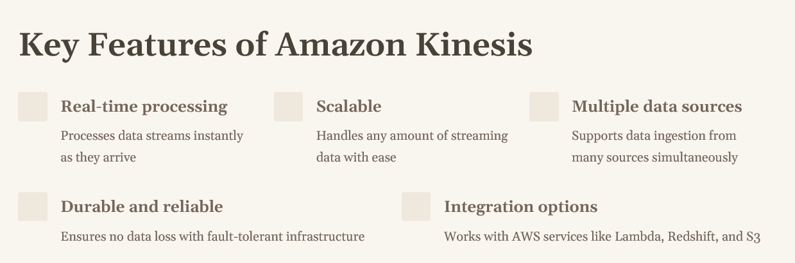
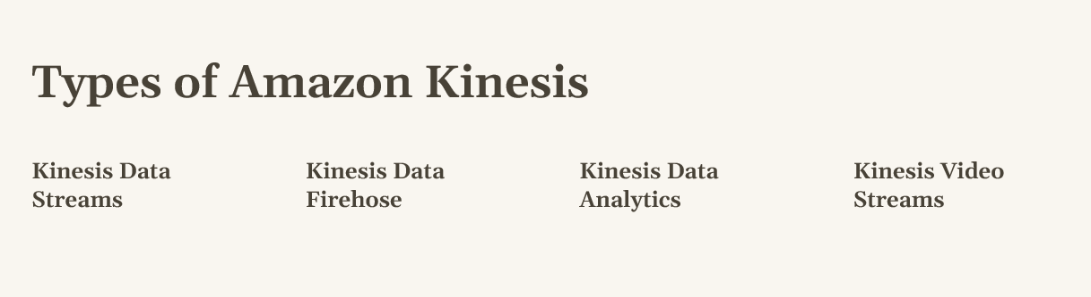
AMAZON KINESIS

Slide 15
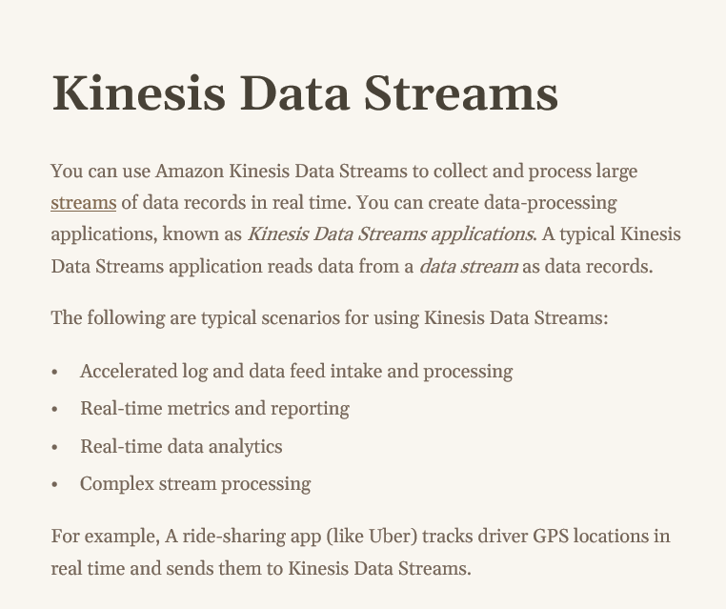
AMAZON KINESIS

Slide 16
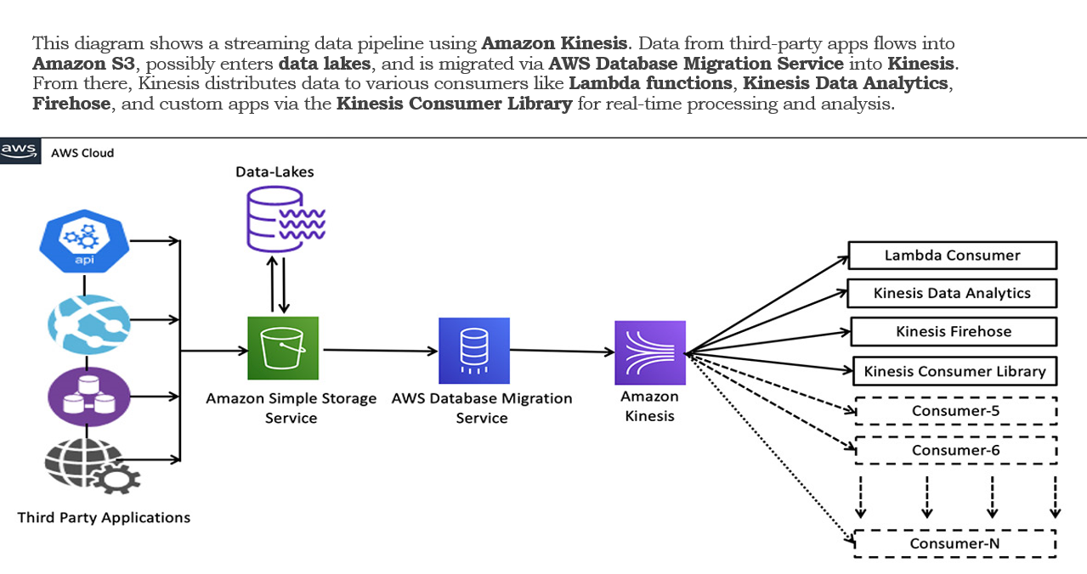
AMAZON KINESIS

Slide 17
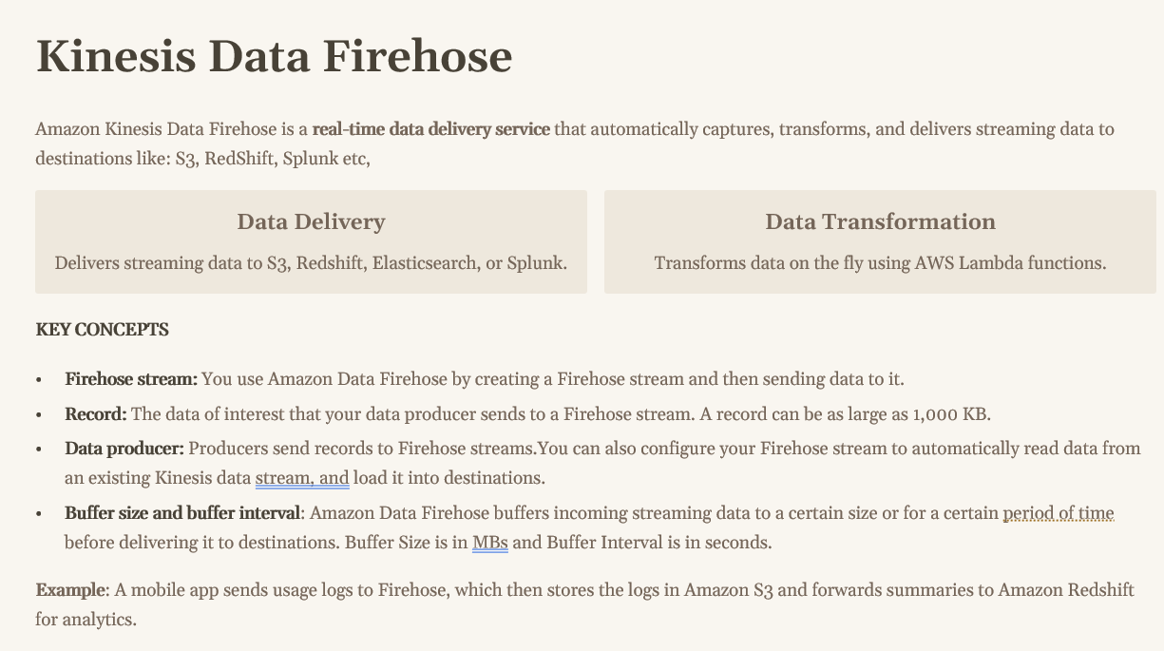
AMAZON KINESIS

Slide 18
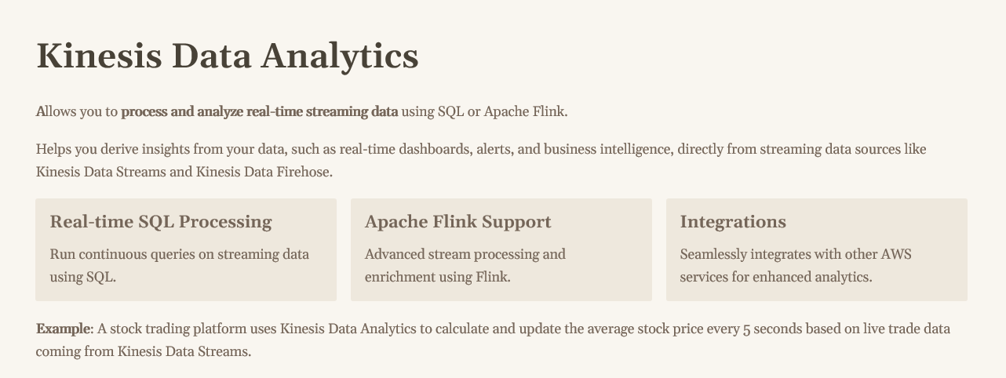
AMAZON KINESIS

Slide 19
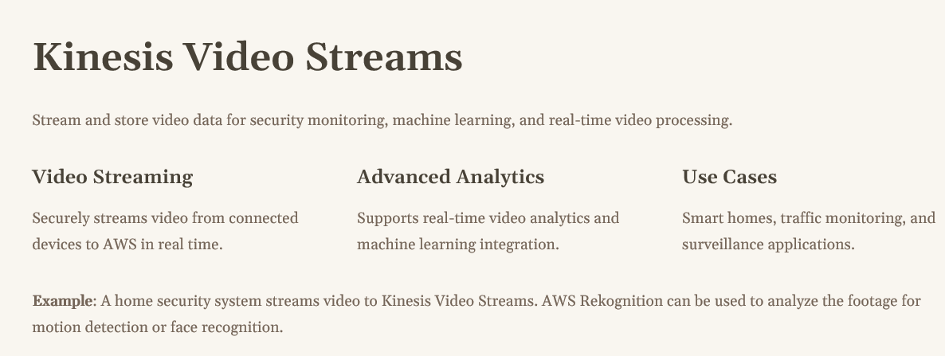
AMAZON KINESIS

Slide 20
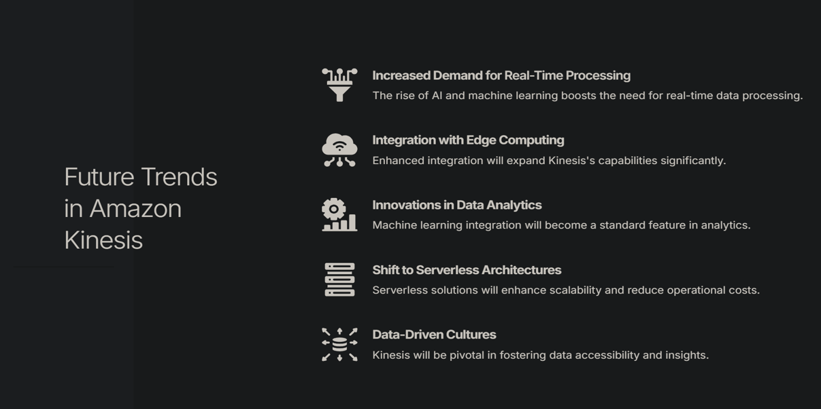
AMAZON KINESIS

Slide 21
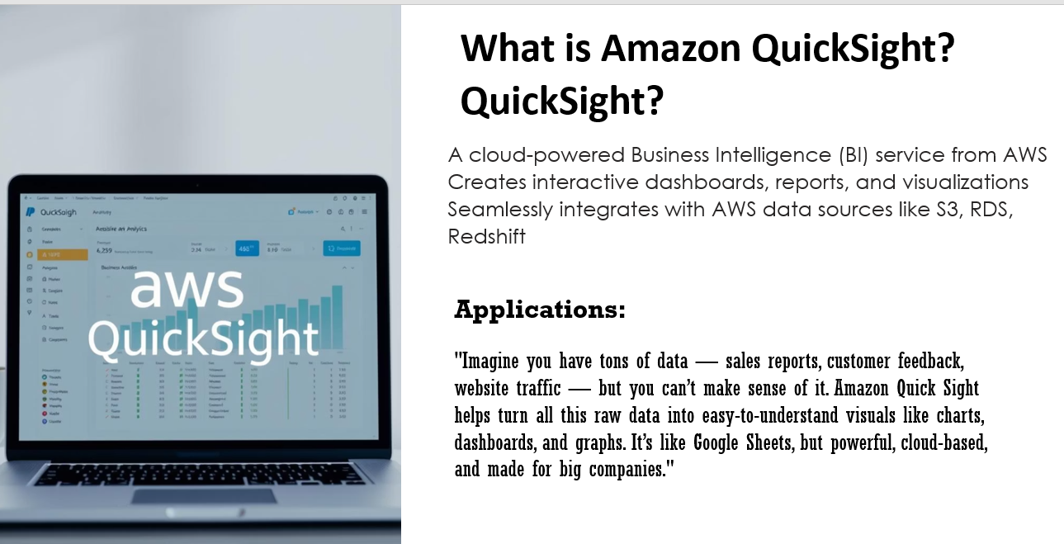
AMAZON QUICKSIGHT

Slide 22
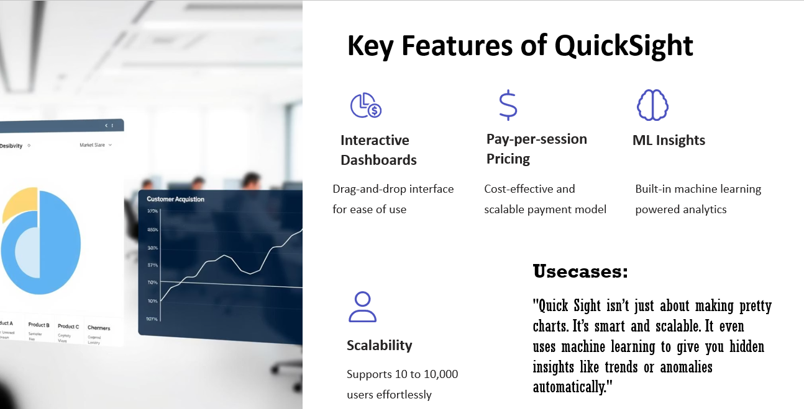
AMAZON QUICKSIGHT

Slide 23
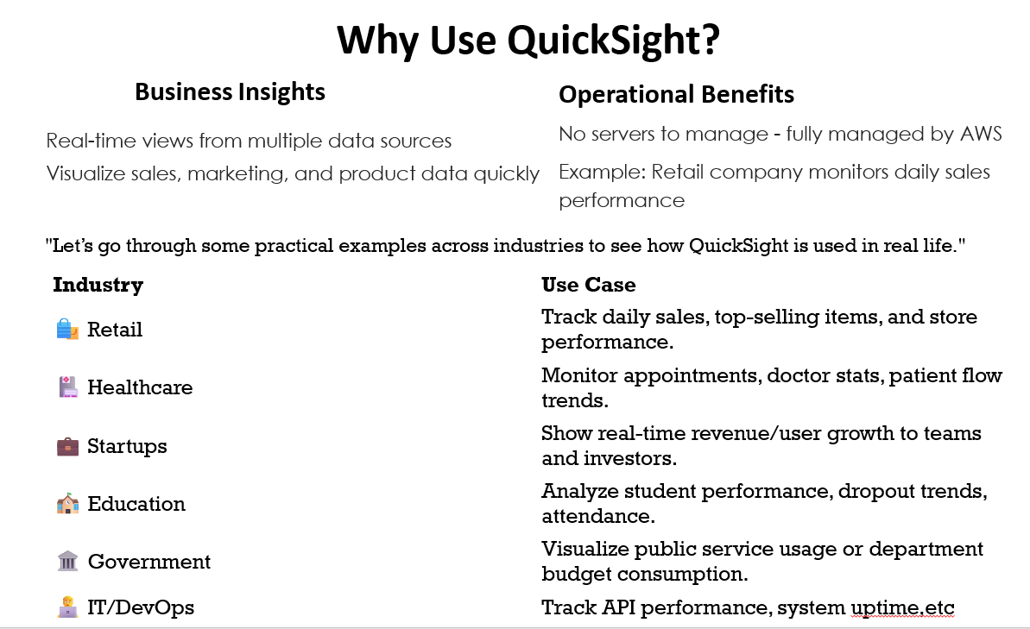
AMAZON QUICKSIGHT

Slide 24
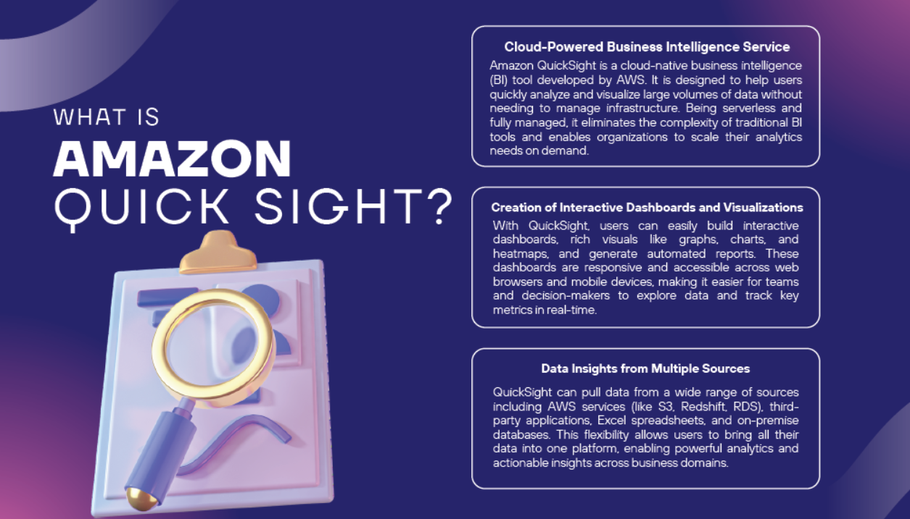
AMAZON QUICKSIGHT

Slide 25
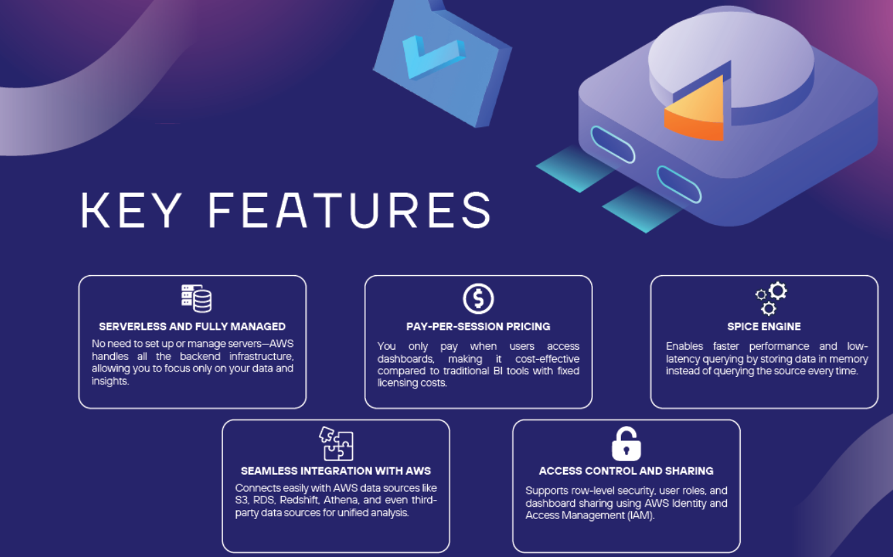
AMAZON QUICKSIGHT

Slide 26
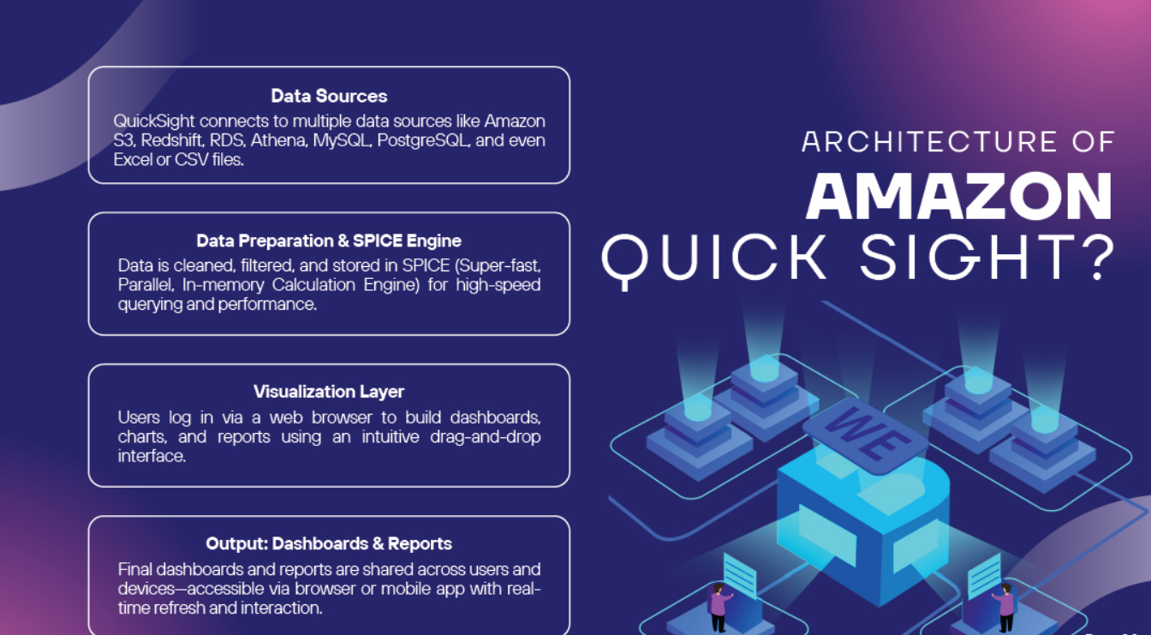
AMAZON QUICKSIGHT

Slide 27
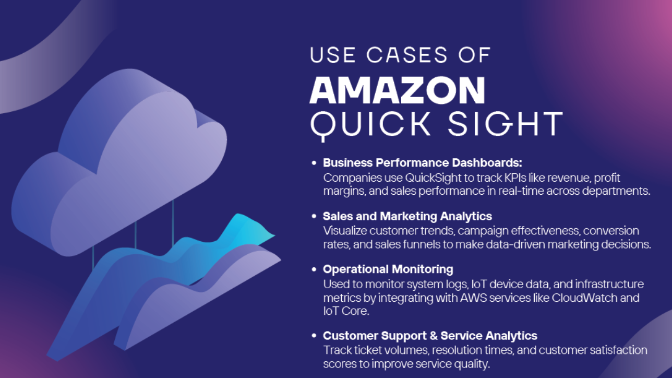
AMAZON QUICKSIGHT

Slide 28
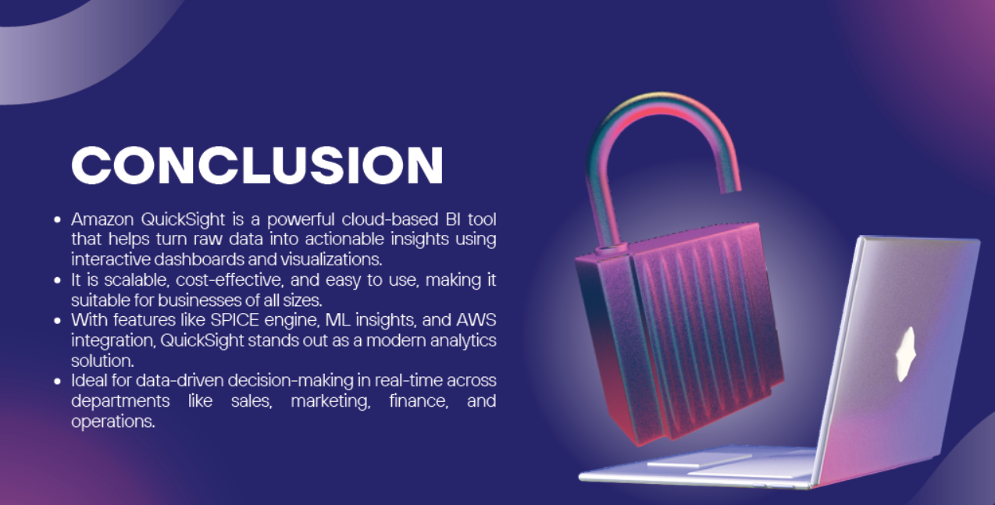
AMAZON QUICKSIGHT

Slide 29
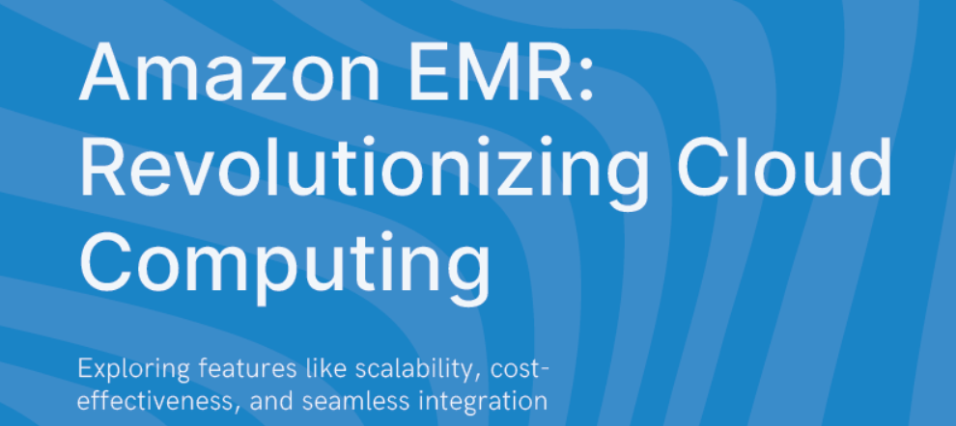
AMAZON EMR

Slide 30
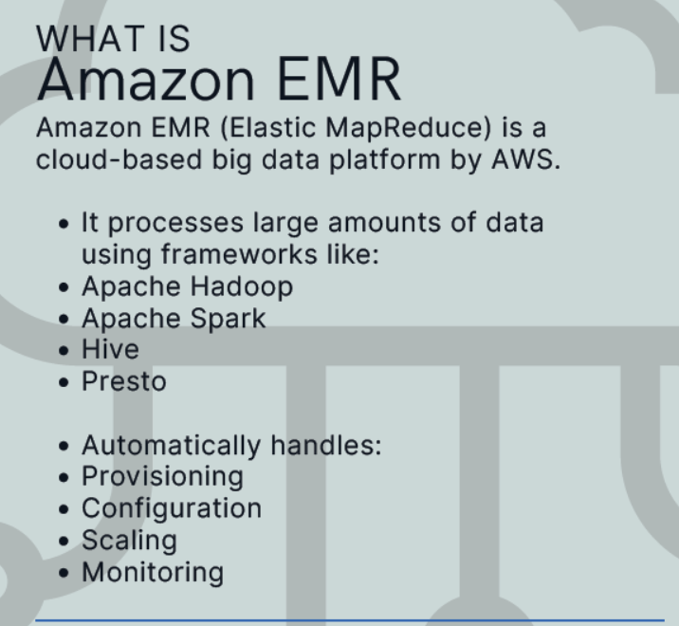
AMAZON EMR

Slide 31
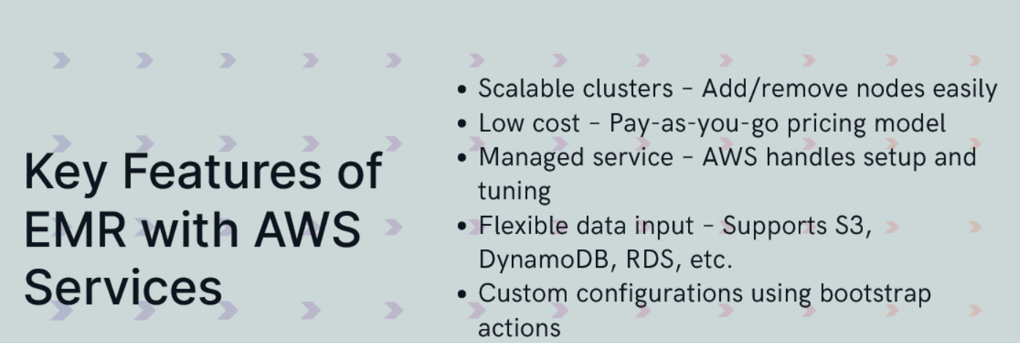
AMAZON EMR

Slide 32
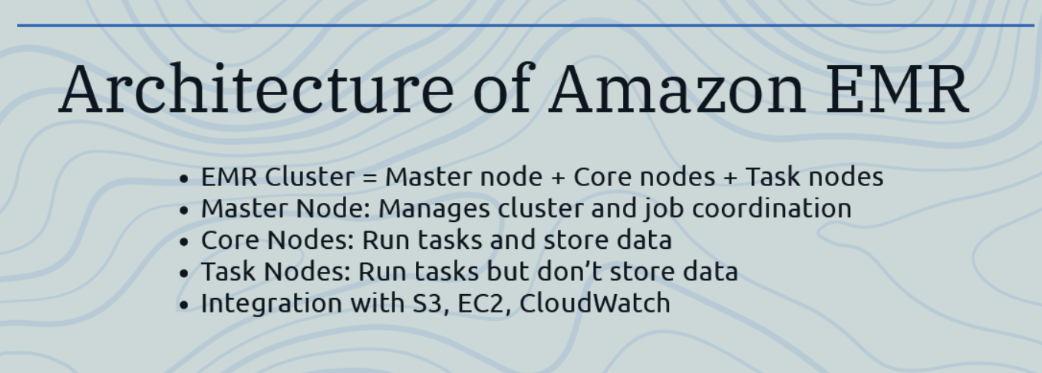
AMAZON EMR

Slide 33
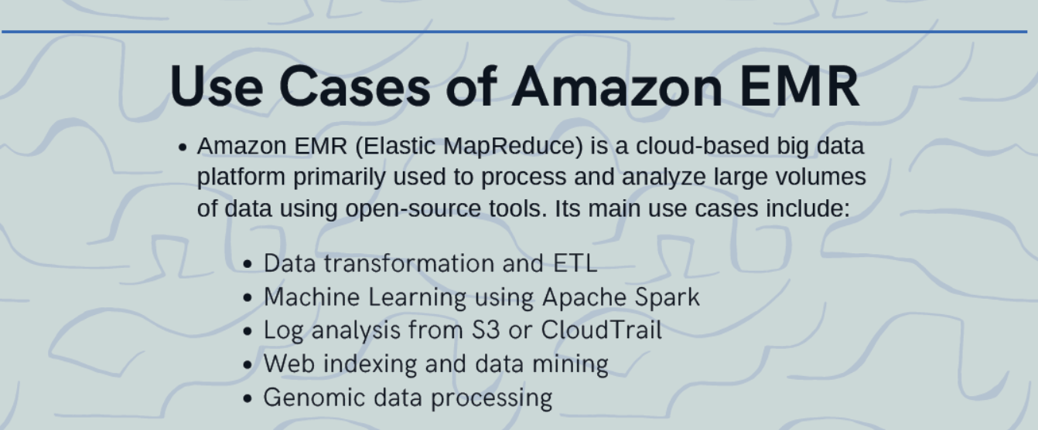
AMAZON EMR

Slide 34
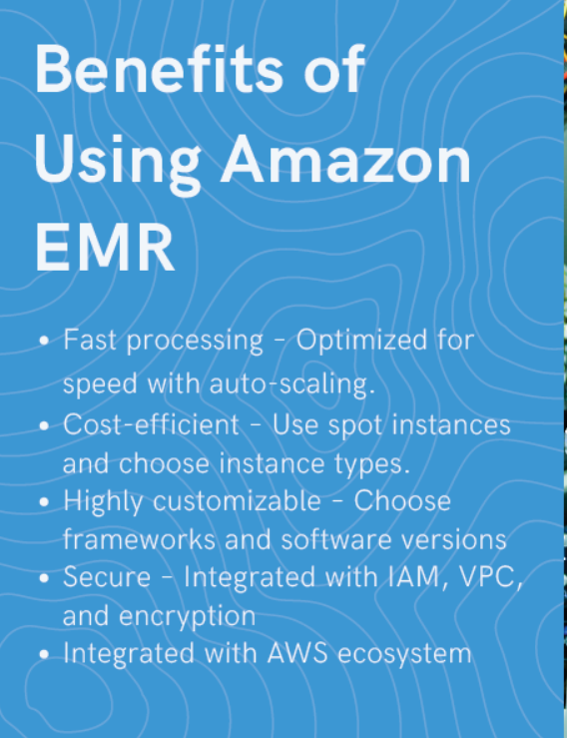
AMAZON EMR

Slide 35


